Slide 1
This weekend we’ve seen further important progress with beam commissioning in the LHC at 450 GeV. On Friday evening, 4 December, beam circulated with more than one proton bunch for the first time. This was another significant step towards running at useful beam intensities.
Then in the early hours of Sunday, the operators succeeded in circulating four bunches in each of the LHC’s two beams and announced stable beams for the experiments. On Sunday evening there was further stable running with higher-intensity bunches. All six LHC experiments have observed collisions and collected useful quantities of data. They were able immediately to begin checking the operation of their detectors, with excellent results that augur well for the future.
Rolf Heuer, today

Slide 2
Brief news from the 8:30 meeting, 07.12.2009
Achieved:
Tweaked up SPS intensity.
Re-established beams after access
STABLE BEAMS from 22:30, 4x4, 6e9 p/bch
Around 00:30, beam dump, cryo down s45, requires access.
More from the experiments in today's LPC weekly meeting.
Program for today, 07.12.2009:
Access till 19:00 (update in afternoon).
Set up SPS with few e10 intensity, bring beams
down the transfer lines (Pt2 and Pt8 closed).
Re-establish beams, then STABLE BEAMS 4x4 6-7e9 p/bch
for the night.
Keep taking data till ~8:00 tomorrow.
Then, one hour of data with LHCb dipole off (change
In ADJUST at end of fill or with no beam and refill).
Look ahead:
Alternate between STABLE BEAMS, studies for increased
intensity and trial ramps.

Slide 3
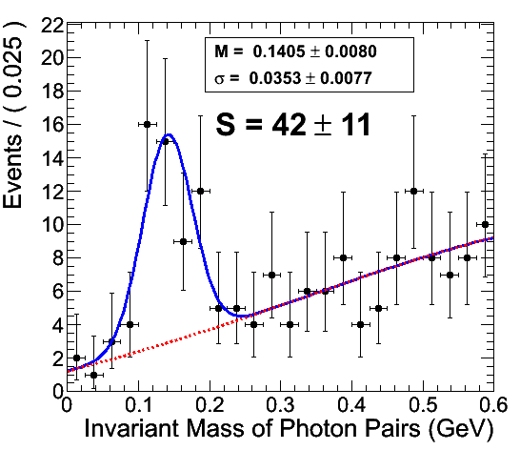
π⁰ study with 900 GeV data
From eCal group
Endcaps (with preShower cluster corrections = For each endcap cluster, hits in both X and Y preshower layer are clustered by the standard preshower clustering algorithm. )

Slide 4
From Particle Flow group

Slide 5
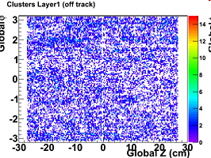
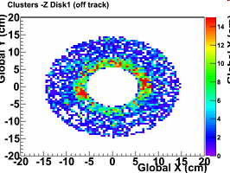
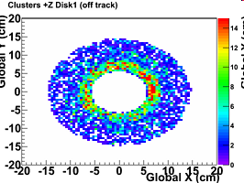
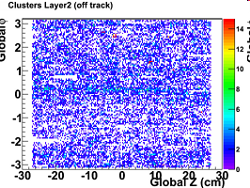
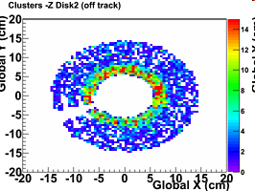
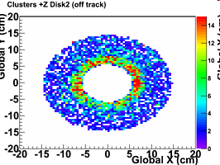
Pixel is on : “No evidence of beam induced noise in the pixel detector!”
Run 123151 - Cluster Occupancy Maps
L3

Slide 7
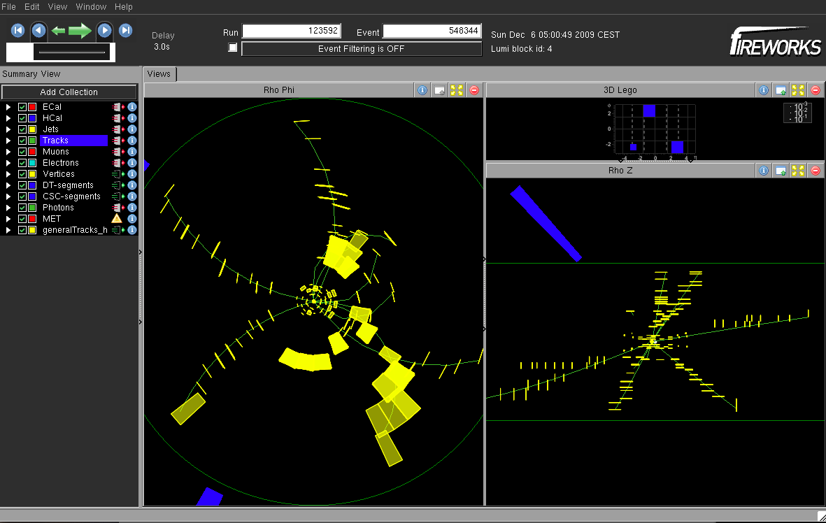
Event displays of one of the first collision reconstructed with the Tracker
https://twiki.cern.ch/twiki/bin/viewauth/CMS/TKPOGCollisions900GeVDec

Slide 8
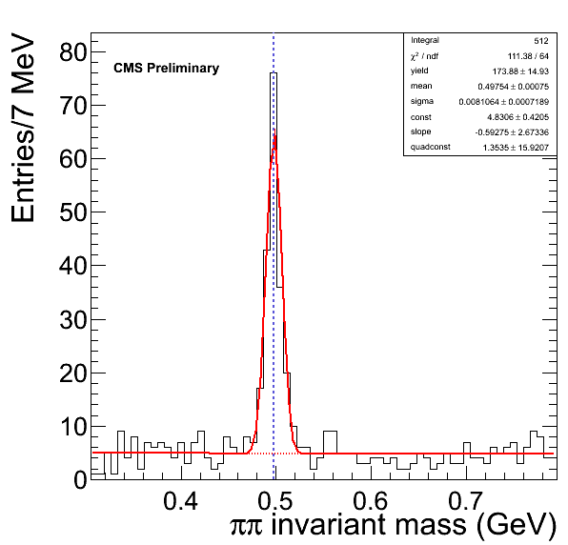
K0S mass plot

Slide 9
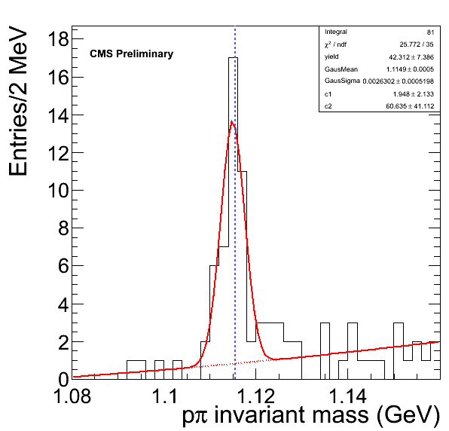
Lambda mass plot

Slide 10
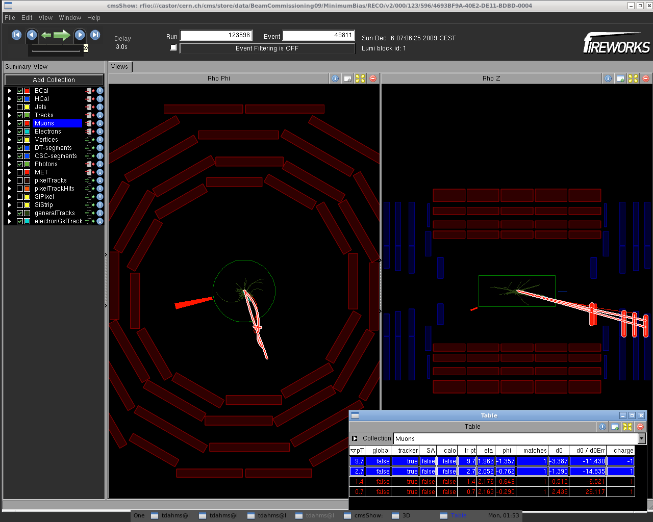
Dimuons in Real Data
Opposite-sign muon pair of M = 3 GeV and p_{T} = 12.0 GeV
https://twiki.cern.ch/twiki/bin/viewauth/CMS/QuarkoniaFirstCollisions

Slide 11
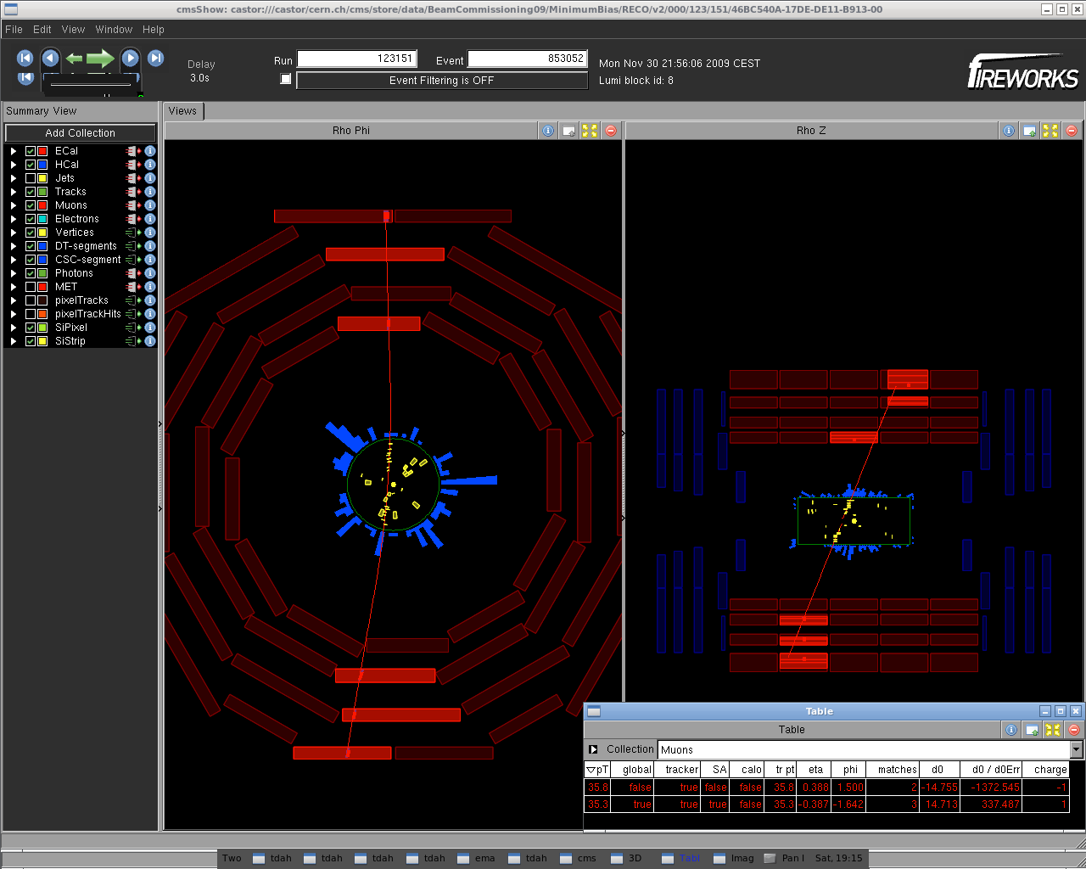
A fake "real dimuon" in r-phi and r-z view (m_{inv} = 76.5 GeV, p_{T} = 0.5 GeV):

